Slide 1



InvestPro: Empowering Your Investment Success
Team Members:
Japneet Kaur (2210990433)
Japneet Singh (2210990434)
Jasneet Arora (2210990451)
Submitted to:
Dr. Baljit Kaur
Mr. Vikas Patel

Slide 2


Table of Contents
Problem Statement
Introduction
Objectives
Technical Details
Key Features
Dashboard Snapshots
Explore Our Project
References

Slide 3

Problem Statement
Introducing the challenges faced by investors:
Complex Tracking: Investors face challenges in effectively tracking dynamic stock market trends and global economic indicators due to the lack of user-friendliness in current solutions.
Insufficient Insights: Existing platforms do not provide comprehensive insights, resulting in information overload and hindering well-informed decision-making.

Slide 4


Introduction
Introducing InvestPro, an innovative stock market dashboard, engineered for your investment success. InvestPro provides a sophisticated platform that delivers live stock market updates.
Real-time data and analysis are essential for informed investment decisions and risk mitigation. InvestPro keeps investors well-informed, enabling confident decision-making and effortless navigation of the complex investment landscape.

Slide 5

Objectives
InvestPro is designed to meet the evolving needs of the financial world with the following objectives:
User-Friendly Interface:
Create an intuitive interface for seamless navigation and interaction.
Real-Time Data and Analysis:
Provide tools for real-time data delivery, keeping investors updated on market developments instantly.
Simplified Monitoring:
Streamline the monitoring of stock market trends, eliminating unnecessary complexities.
Global Economic Indicators:
Integrate a comprehensive set of global economic indicators into the platform.

Slide 6

Technical Details
Frontend Technologies Used:
HTML (Hypertext Markup Language): Structures the dashboard's content.
CSS (Cascading Style Sheets): Styles the dashboard
JavaScript: Adds interactivity to the dashboard
API Integration:
To fetch real-time stock market data and display it on the dashboard.
Tools Used:
Visual Studio Code (VS Code): The primary code editor for developing the dashboard.
Microsoft Edge/ Google Chrome: To test the compatibility and performance of the dashboard.

Slide 7
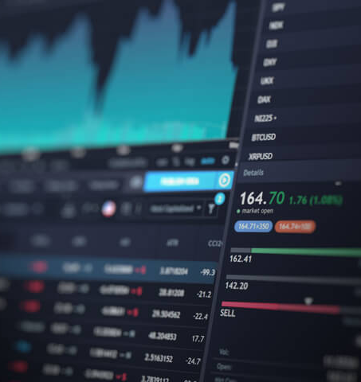
Key Features
InvestPro offers a range of powerful features designed to empower investors and enhance their decision-making process:
Real-Time Data Updates: Provides users with real-time updates on stock prices, market trends, and economic indicators.
Sophisticated Analysis Tools: Includes interactive charts and analysis tools to meet diverse investor needs.
User-Friendly Interface: Intuitive design for seamless navigation and interaction.
Information Empowerment: Commits to delivering accurate, timely, and relevant information.

Slide 8
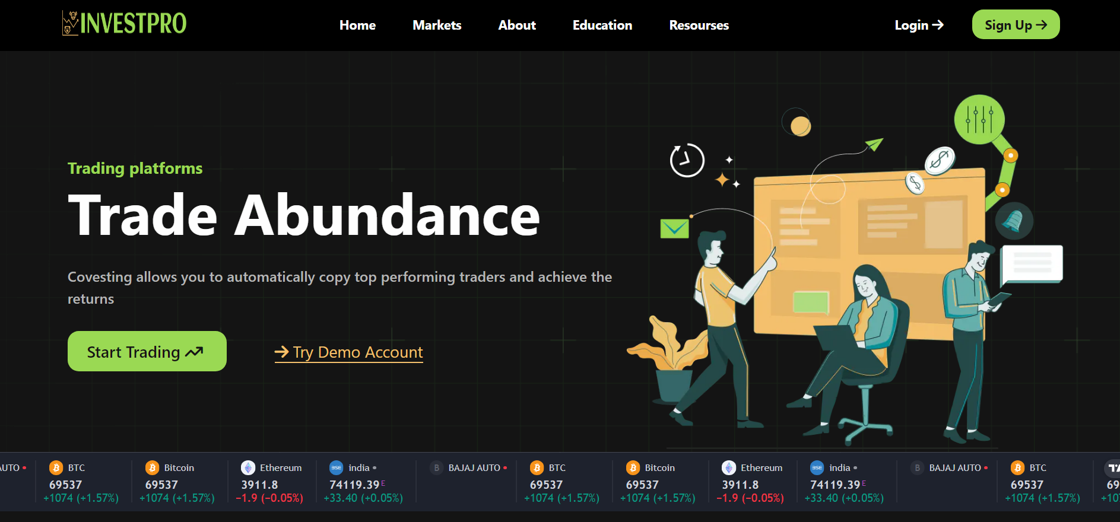
Dashboard Snapshots

Slide 9
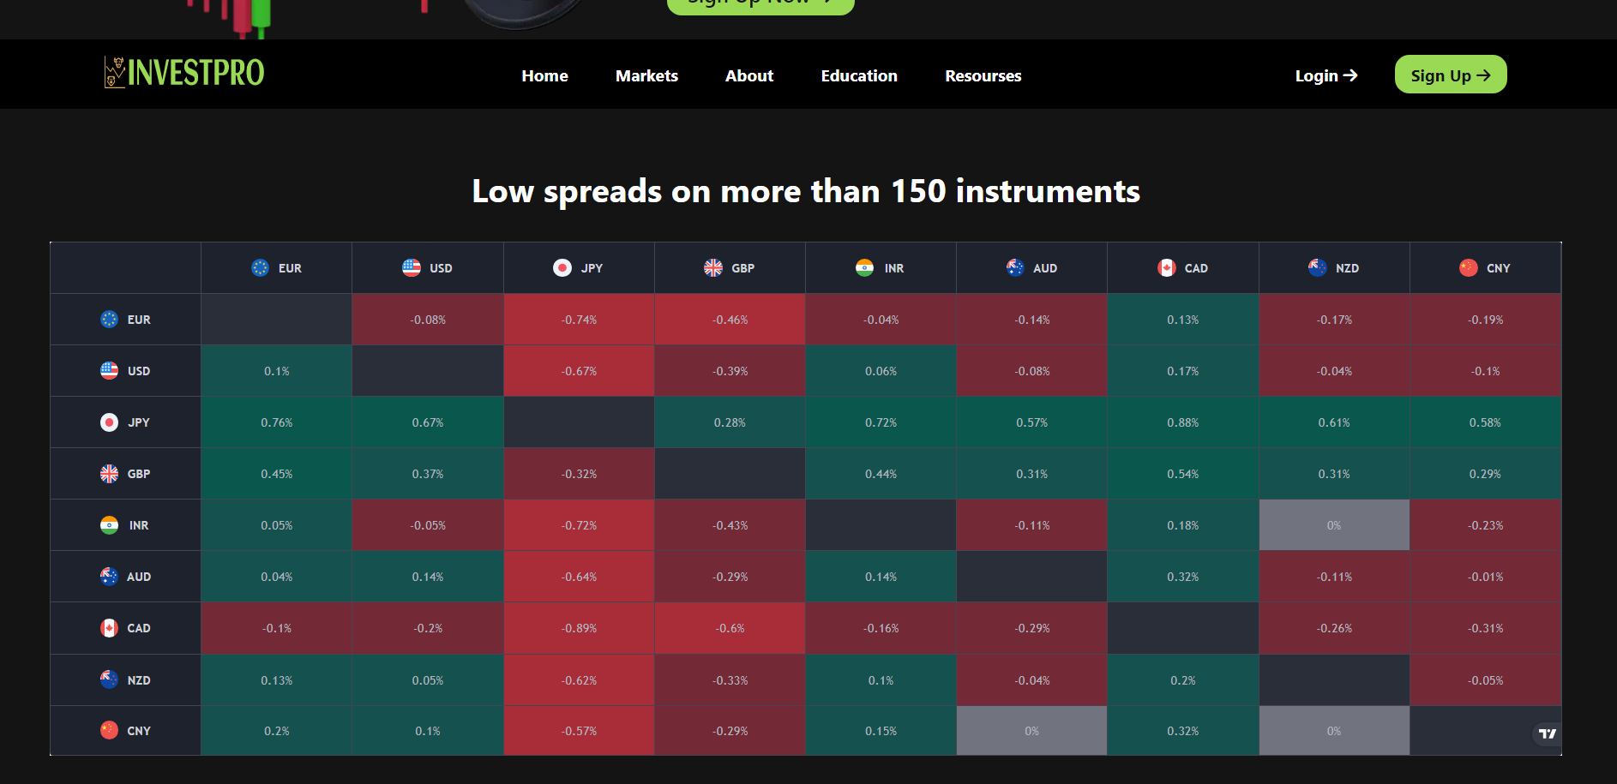
Dashboard Snapshots

Slide 10
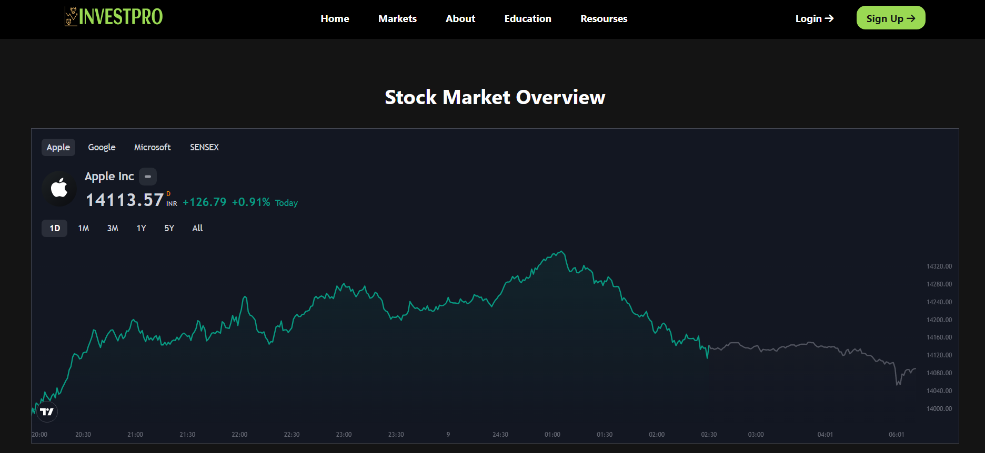
Dashboard Snapshots

Slide 11
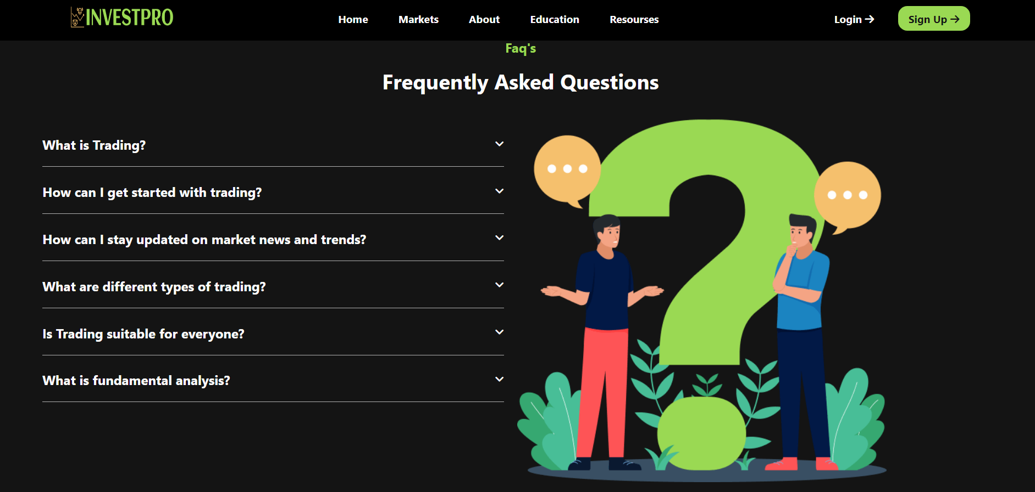
Dashboard Snapshots

Slide 12

Explore Our Project
GitHub Repository: https://github.com/jasneet-arora27/InvestPro-Empowering-Your-Investment-Success.git
Live Website Host Link: https://investpro-six.vercel.app/

Slide 13

References
Youtube: https://www.youtube.com/
GitHub: https://www.github.com/
w3 Schools: https://www.w3schools.com/
Vercel: https://vercel.com/
APIs:
Ticker Tape: https://s3.tradingview.com/external-embedding/embed-widget-ticker-tape.js
Forex Heatmap: https://s3.tradingview.com/external-embedding/embed-widget-forex-heat-map.js
Symbol Overview: https://s3.tradingview.com/external-embedding/embed-widget-symbol-overview.js

Slide 14


